Slide 1
Unit 9
Structure and Union

Slide 2
What is structure?
A structure is a collection of variables under a single name.
Arrays allow to define type of variables that can hold several data items of the same kind.
Similarly structure is another user defined data type available in C that allows to combine data items of different kinds.
A structure is a convenient way of grouping several pieces of related information together.

Slide 3
What is structure?
A structure is a convenient tool for handling a group of logically related data items.
For ex: name, roll, fee, marks, address, gender and phone are related information of a student.
To store information about a student, we would require to store the name of the student which is array of characters, roll of student which is integer type of data and so on.
These attributes of students can be grouped into a single entity, student. Here, student is known as structure which organizes different data times in a more meaningful way.

Slide 4
Defining a structure
Syntax:
struct structure_name{
data_type member_variable1;
data_type member_variable1;
data_type member_variable1;
….........
….........
data_type member_variable1;
};
Once structure_name is declared as new data type, then variables of that type can be declared as
struct structure_name structure_variable;

Slide 5
Example for structure
Let us create a structure named student that has name, roll, marks and remarks as members.
struct student{
char name[20];
int roll;
float marks;
char remarks;
};
Here, student is structure name and its members are name, roll, marks and remarks.

Slide 6
So from before example, student is new data type and various variables of type struct student can be declared as:
struct student st;
Similarly multiple variables can also be declared:
struct student st1, st2,st3;
The member variables are accessed using dot (.)operator.
Each member variable of structure has its own copy of member variables.
For ex: st1.name is member variable, name of st1 structure variable.
st2.roll is member variable, roll of st2 structure variable.
We can also write as:
struct student{
char name[20];
int roll;
float marks;
char remarks;
}st1, st2;

Slide 7
DIY
Create structure date which has property day, year and month.
Create structure book which has property …, .... ,....,....
Create structure employee which has property …, .... ,....,....
Create structure account which has property …, .... ,....,....
Create structure department store which has property …, .... ,....,....
YOU HAVE 5 MINUTES!!!!

Slide 8
examples
struct date { int day; int month; int year; } | struct book{ char title[25]; char author[20]; int pages; float price; }b1,b2; | struct epmployee{ int emp_id; char emp_name[20]; int age; char gender; float salary; }b1,b2; | struct account{ int acc_no; char acc_type[20]; float balance; };

Slide 9
Structure Initialization
The values to be initialized must appear in order as in the definition of structure within braces and separated by commas.
C does not allow the initialization of individual structure members within its definition.
struct student{
char name[20];
int roll;
float marks;
};
A variable of this type can be initialized during its declaration as shown below
struct student st={“Ram”, 12, 55.4};
This line is similar to
struct student st;
st.name=“Ram”;
st.roll=12;
st.marks=55.4;

Slide 10
How Structure Elements Are Stored
The elements of a structure are always stored in contiguous memory location.
A structure variable reserves number of bytes equal to sum of bytes needed to each of its members.
For ex: struct student{
int roll;
float marks;
char remarks;
}st;
Here, structure student’s variables st takes 7 bytes in memory as its member variable roll needs 2bytes, marks needs 4 bytes and remarks needs 1 byte.

Slide 11
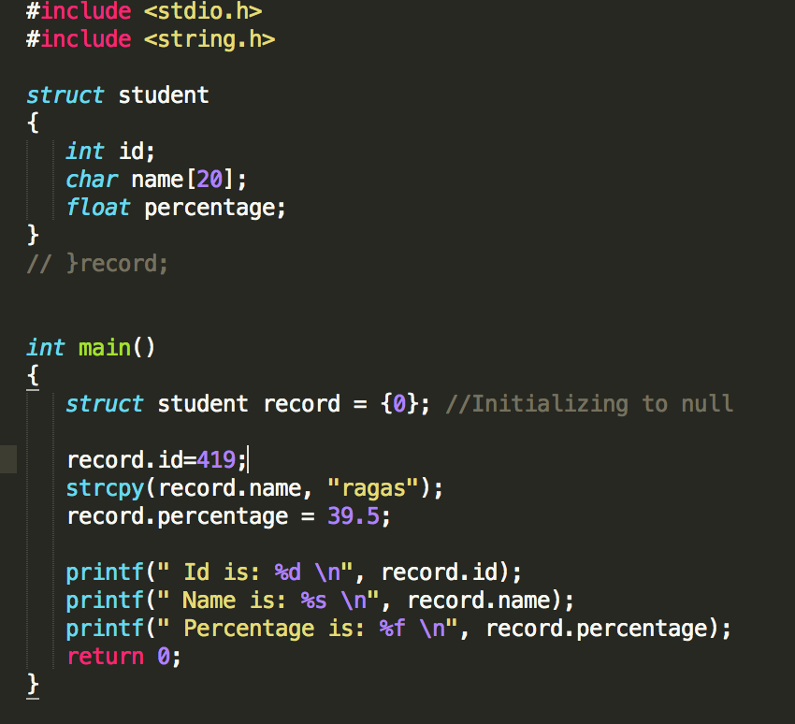
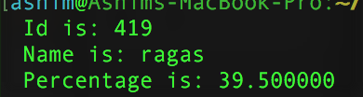
OUTPUT

Slide 12
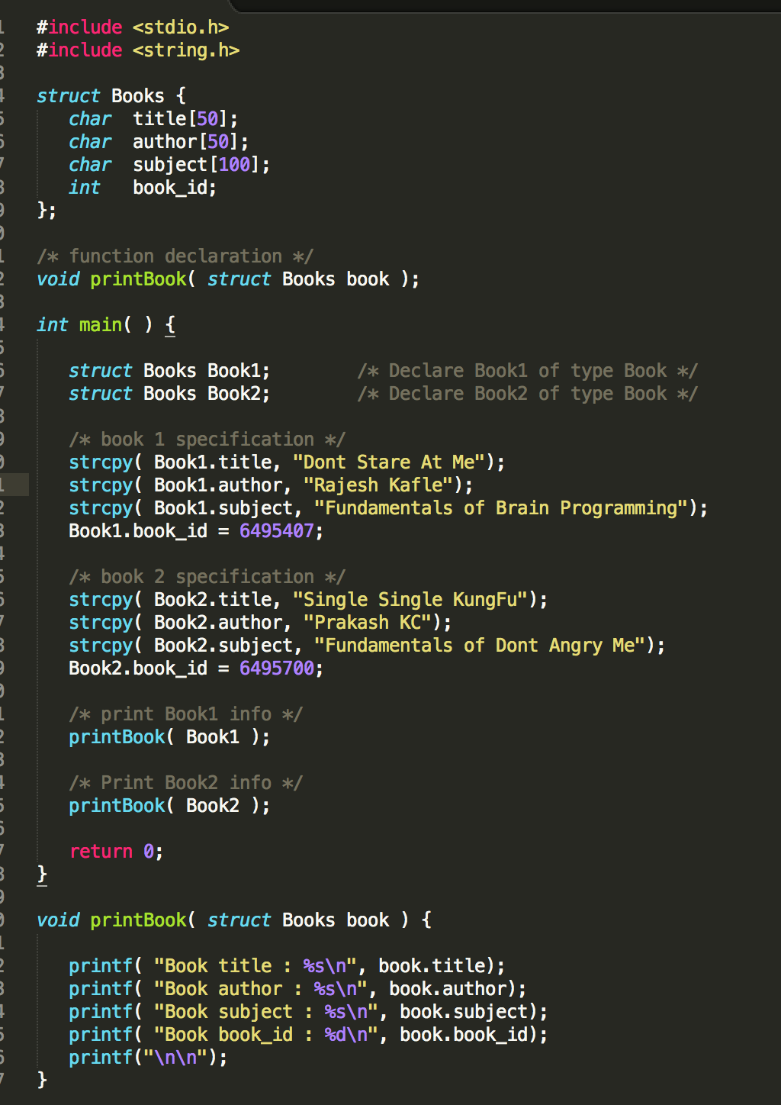
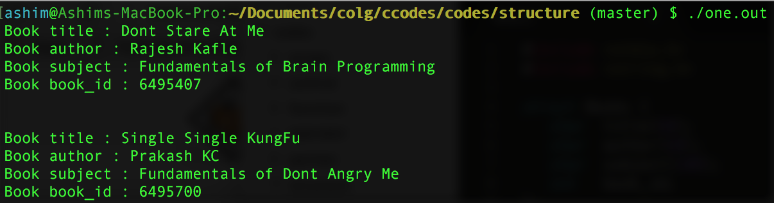
Output

Slide 13
DIY
Create a structure named student that has name, roll, marks and remarks as members. WAP to read and display data entered by the user.
Create a structure named employee as members. WAP to read and display data entered by the user.

Slide 14
Array Of Structure

Slide 21
References:
http://www.studytonight.com/c/structures-in-c.php
http://www.tutorialspoint.com/cprogramming/c_structures.htm
http://www.javakode.com/c-programming/c-structures/
http://c.learncodethehardway.org/book/ex16.html

